Slide 1


H MICIDE
TRENDS AND CONNECTIONS IN THE US
2007-2017
Karen McGee | Andrea Morgan | Stacey Smith

Slide 2

It’s everywhere
Utilizing historical FBI victim data as our main source, our goal was to discover trends that could help define where, when and how homicide occurs most in the United States.

Slide 3
INITIAL QUESTIONS Our questions stemmed from the initial exploration of the FBI Crime API
What age victim is most common?
Are homicide numbers increasing?
Are more victims male or female?
What kind of relationships do victims have with their offenders?
Does state data provide more insight versus national data?

Slide 4
QUESTIONS 2.0 Our second exploration stemmed from our own curiosity, where we researched to see if we could find relationships between homicide and:
Location
Economic status
Weapon usage
Religious affiliations and cults
Mental health trends in the US
Weather
Political climate

Slide 5
FINAL QUESTIONS Based on what we found and thought we could reasonably measure, we are looking at the following topics:
Economic trends by location (Historical census data)
Political trends (Public poll/election data)
Victim relationship to offender (State breakdown of FBI API)

Slide 6
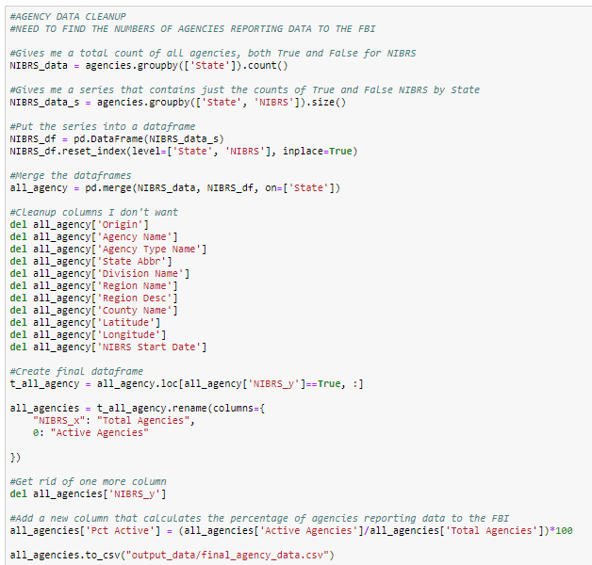
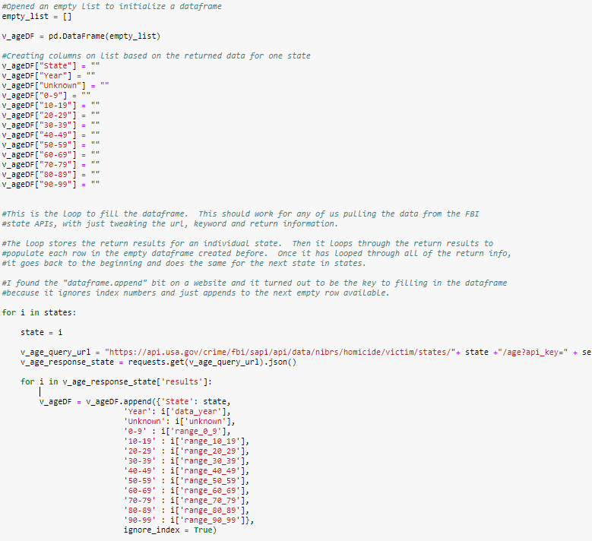
DATA CLEANUP AND EXPLORATION
Building the FBI queries by state was complicated
For the income and relationship data, had to delete and/or rename many columns
In many instances, had to use .loc to extract just one year’s worth of data for each state
Due to discrepancies in reporting, decided to only look at data post 2007

Slide 7
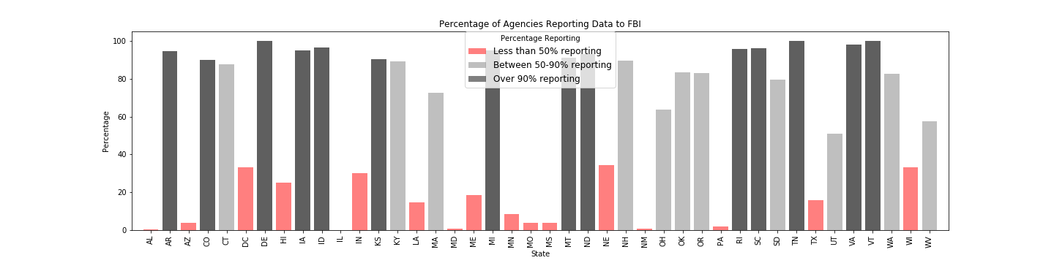
DATA CLEANUP AND EXPLORATION: Agencies Information
The plot shows the number of agencies who send information to the FBI.
States with low homicide numbers may actually just have low or non-existent agency reporting.
Only 42 states report any data at all.
20% of states have agency reporting levels under 5%.
Only three states report at 100%: DE, TN, VT
Data source: FBI Crime Data
Date: unknown/not cited by the FBI. We assume it is current as of 2017, the latest date any data is available

Slide 8
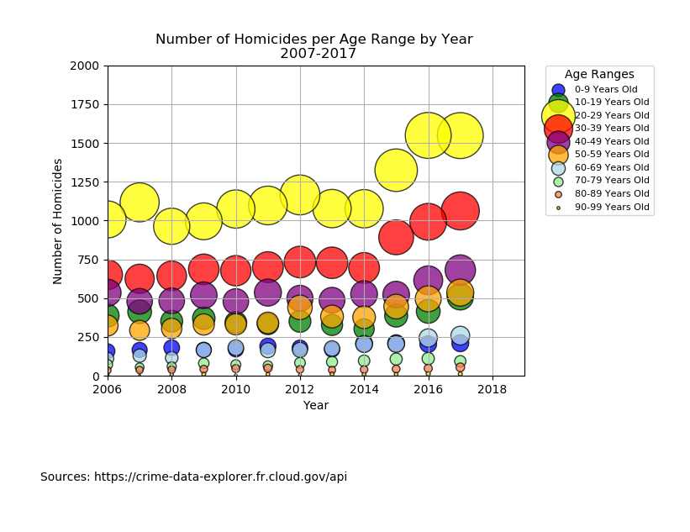
DATA EXPLORATION: US Homicide Counts vs Rates
Homicide counts appear to increase over time
Age group 20-29 has the most number of homicides 2007-2017
At 2014 and later an increase appears to occur across each age group
Does the homicide rate reflect same increase?

Slide 9
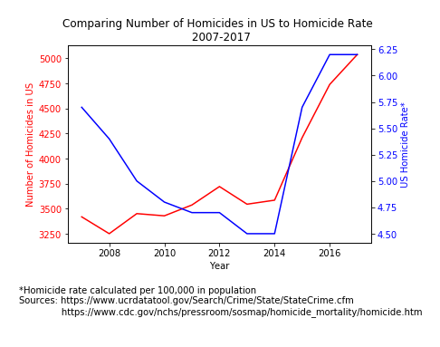
DATA EXPLORATION: US Homicide Counts vs Rates
Increase in number of homicides does not necessarily mean increase in homicide rate
Rates decreased until 2015 despite the number of homicides increasing overall
Sharp increase in both the number and rate in 2015-2016

Slide 10
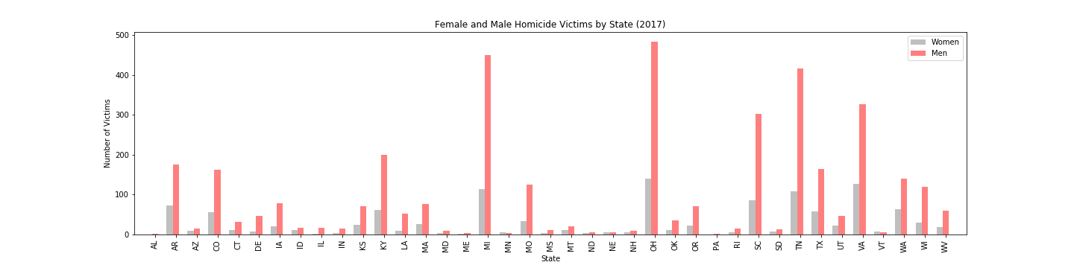
HOMICIDE VICTIMS: Women vs. Men
Hypothesis: The differences in the number of male vs. female
homicide victims is statistically significant.
Conclusion: There is a statistically significant difference between
the number of male vs. female homicide victims.
Data source: FBI Crime Data
Date: 2017

Slide 11
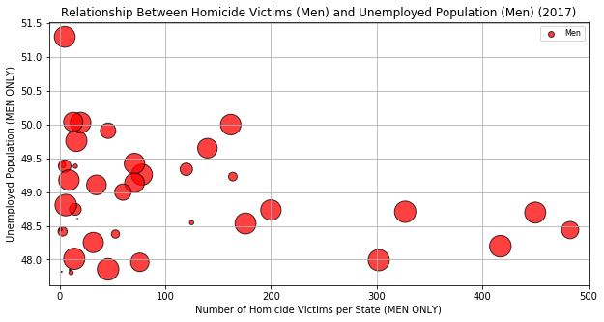
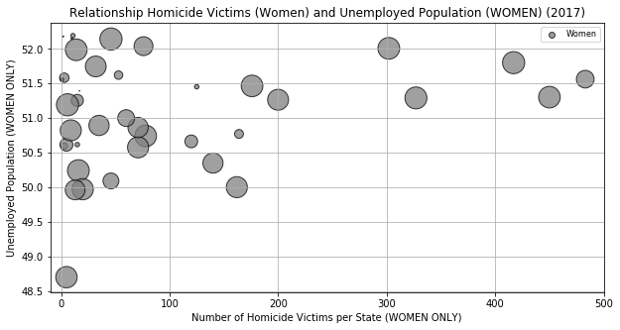
ECONOMIC ANALYSIS: Employment
Is there a relationship between unemployment numbers and homicide?
Census data definition: People aged 16 and older who have worked one or more weeks are classified as having“worked in the past 12 months.” All other people aged 16 and older are classified as“did not work in the past 12 months.”
Data source: FBI Crime Data & Census Data
Date: 2017

Slide 12
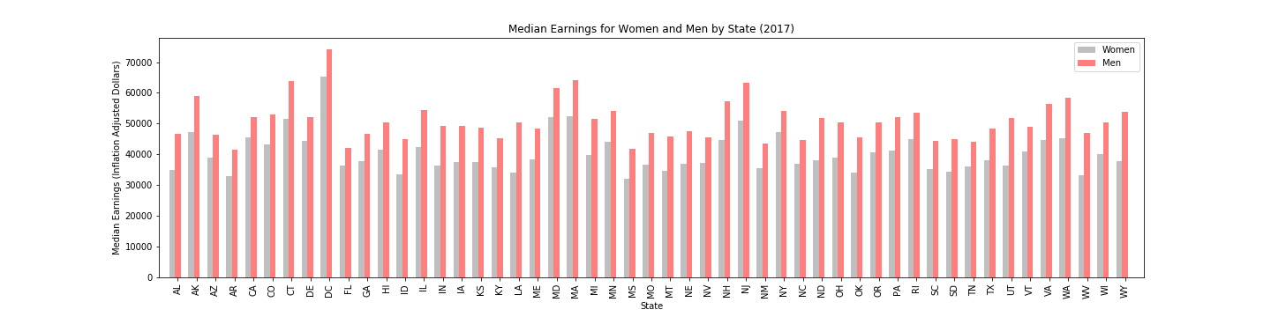
ECONOMIC ANALYSIS: Median Income
Data source: FBI Crime Data & Census Data
Date: 2017

Slide 13
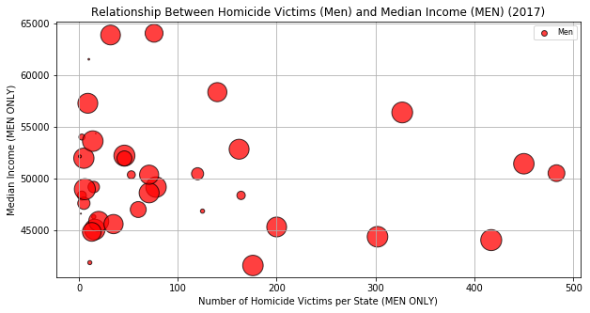
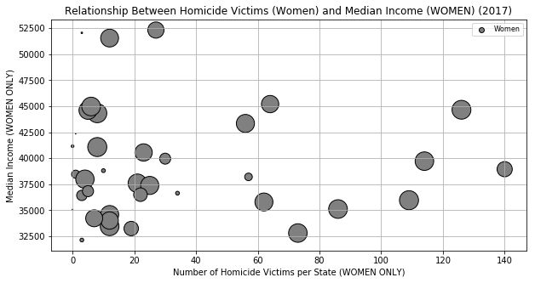
ECONOMIC ANALYSIS: Median Income
Is there a relationship between median income and the number of homicide victims?
Data source: FBI Crime Data & Census Data
Date: 2017

Slide 14
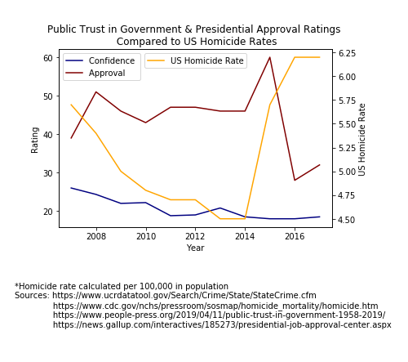
POLITICAL ANALYSIS: Public Opinions
Historical polls from GALLUP (formerly American Institute of Public Opinion) and PEW Research Center
Trust in government decreased over time
Presidential approval had a sharp decline from 2015-2016
Appears to be a“negative” political climate

Slide 15
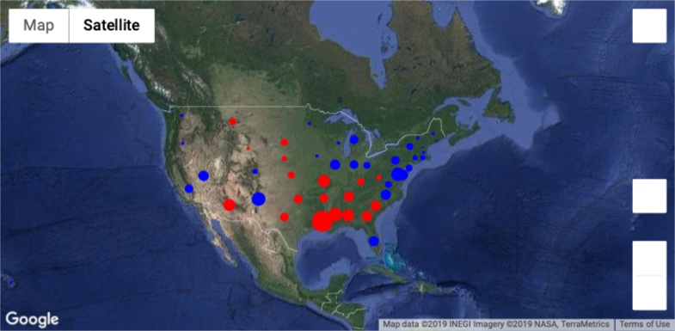
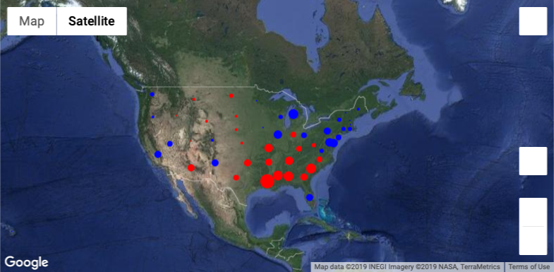
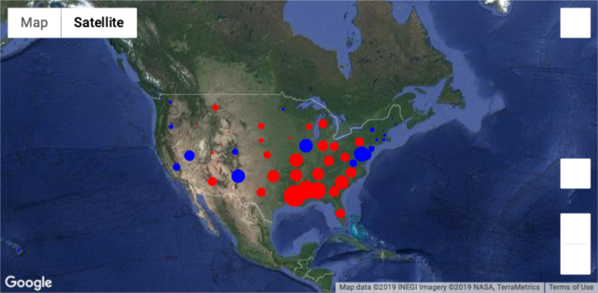
POLITICAL ANALYSIS: State Party
Hypothesis: There is a statistically significant difference in the averages of homicide rates in “Blue”states vs. “Red” states.
The majority of electoral votes designated a state as “Red”(Republican) or “Blue”(Democratic).
The size of a circle depends on the homicide rate for that location.
2008
2012
2016

Slide 16
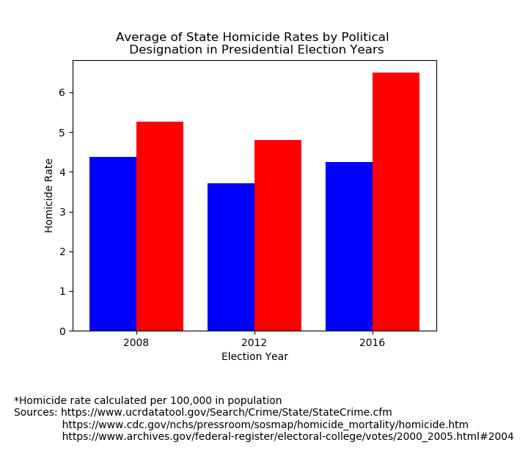
POLITICAL ANALYSIS: State Party
State homicide rates were grouped and averaged for each election year.
Overall, red states appear to have a higher homicide rate, on average, than blue states.
A Ttest says…

Slide 17
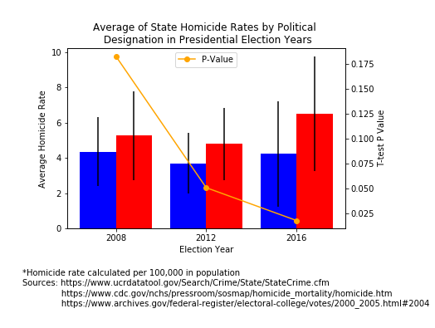
POLITICAL ANALYSIS: State Party
The bars represent the standard deviation of each group.
2008: Null hypothesis
2012: Null hypothesis
2016: There is a statistically significant difference.

Slide 18
RELATIONSHIP CATEGORIES (who the victim was in relationship to the offender)
Intimate Partner | Family | Friend | Professional | Not Related
Spouse | Parent | Friend | Employee | Stranger
Ex-Spouse | Sibling | Acquaintance | Employer | Offender
Boyfriend/girlfriend | Step-child, -parent, -sibling | Neighbor | Babysittee | Otherwise Known
Common law spouse | Child of boyfriend/girlfriend
Homosexual relationship | Grand-child, -parent
 | In-law
 | Other family member

Slide 19
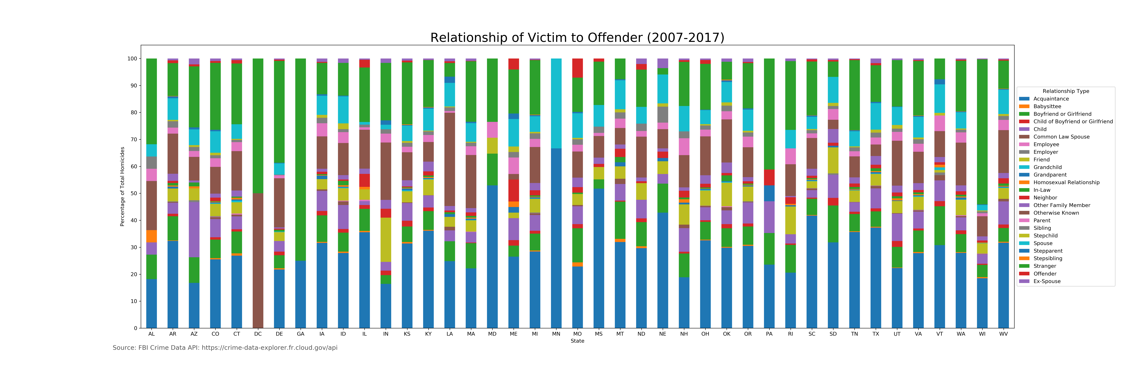
RELATIONSHIPS: By State
This displays the percentage of people murdered in each state by each type of relationship category
Some of the largest categories appear to be acquaintance, stranger, or someone they knew outside of these categories

Slide 20
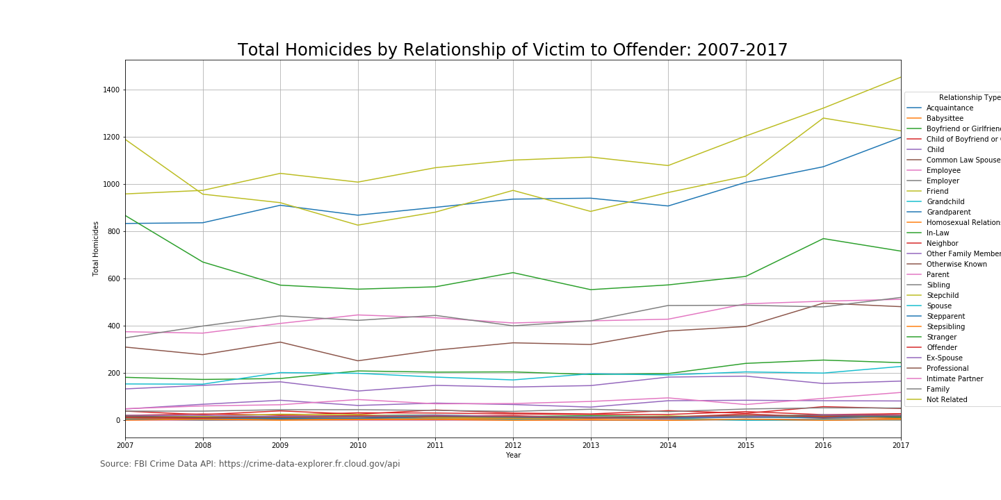
RELATIONSHIPS: Categories vs. Counts
Top four:
Friend
Not related
Acquaintance
Stranger
Upward trend in friends and acquaintances since 2014

Slide 21
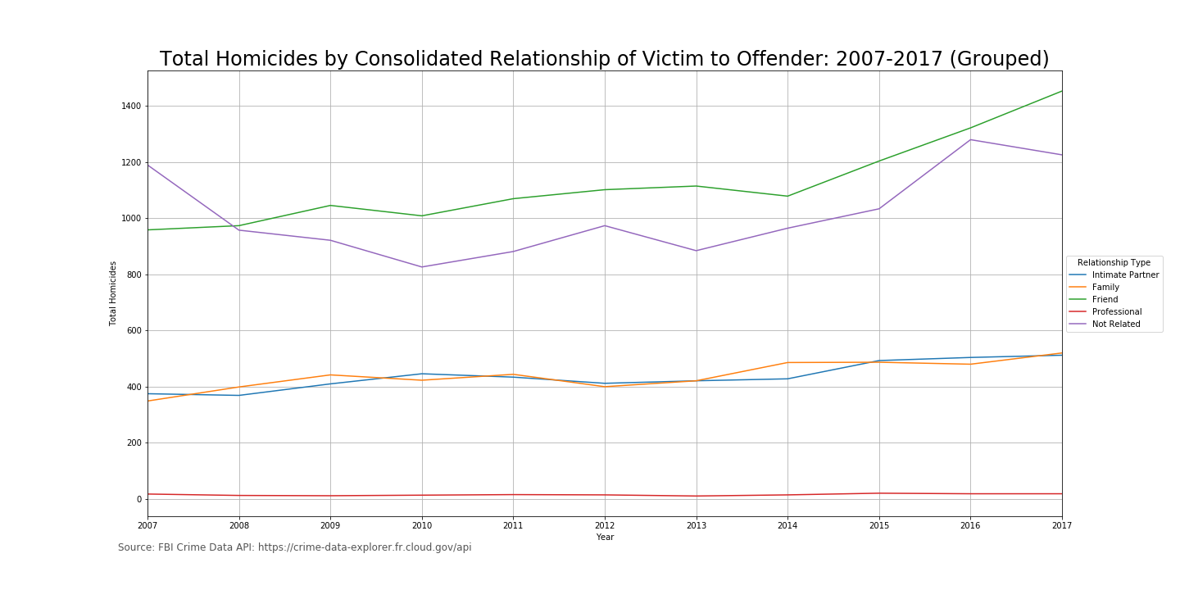
RELATIONSHIPS: Categories vs. Counts
Friend and Not Related are the top two most common
Intimate Partners and Family are the next most common
Professional relationships are the least common

Slide 22
RELATIONSHIPS: By State
The next five maps display the number of homicides from each of the five categories by state, 2007-2017.
Choropleth maps are maps that show differences in values based on the shading of each state.
Some states have more agencies reporting data than others which skews some of the shading. For instance, 100% of Tennessee’s agencies report their homicide data which is why it is consistently on the darker end of the spectrum.

Slide 23
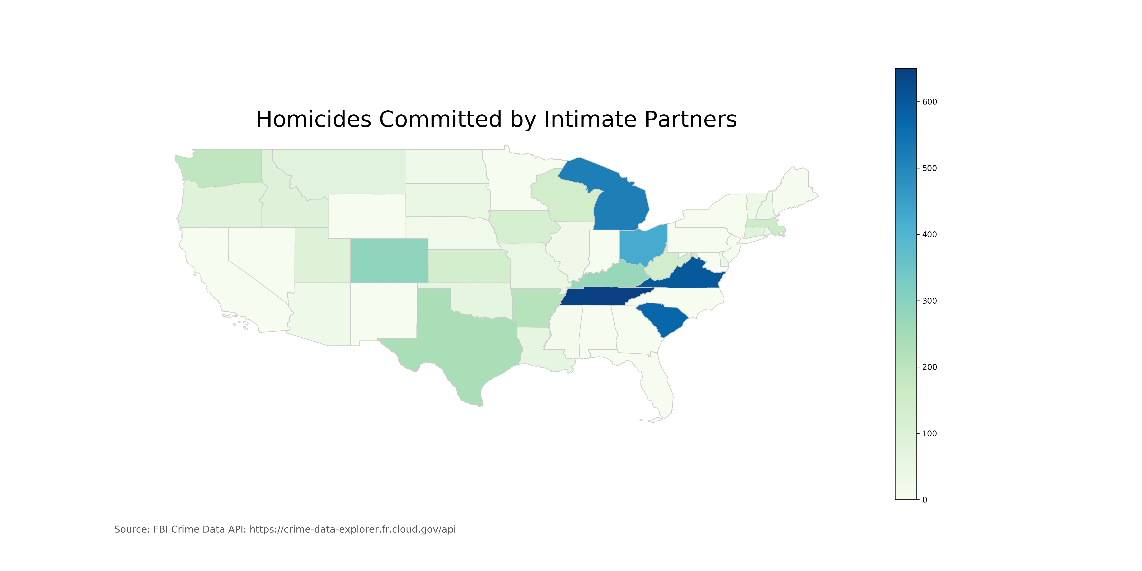

Slide 24
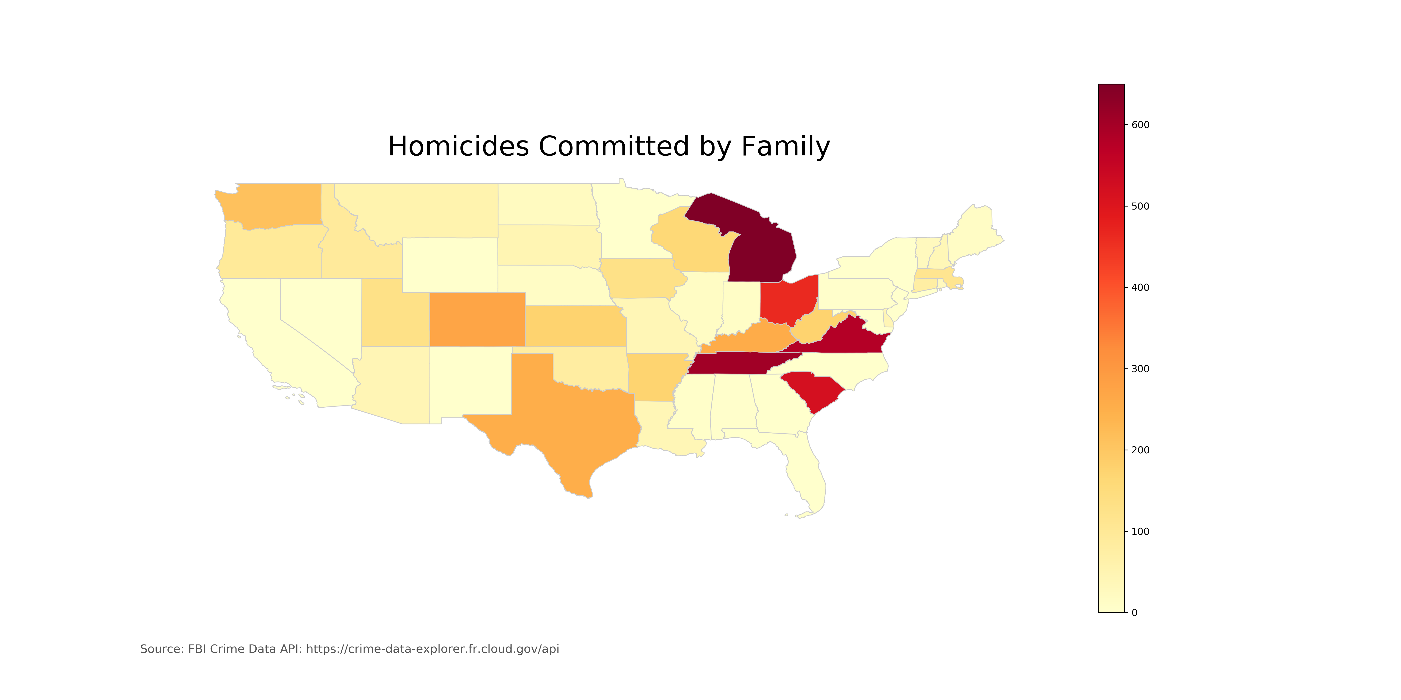

Slide 25
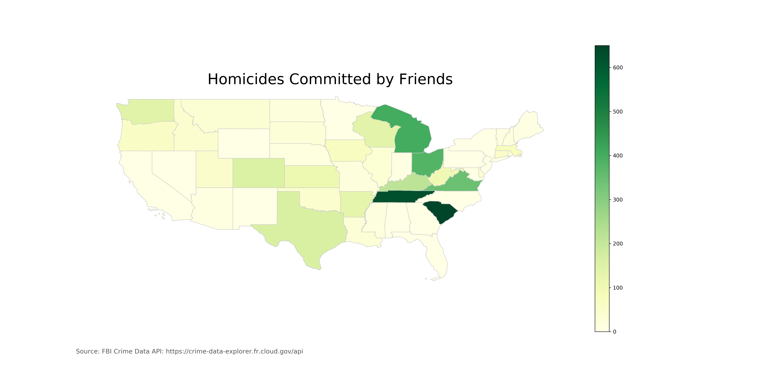

Slide 26
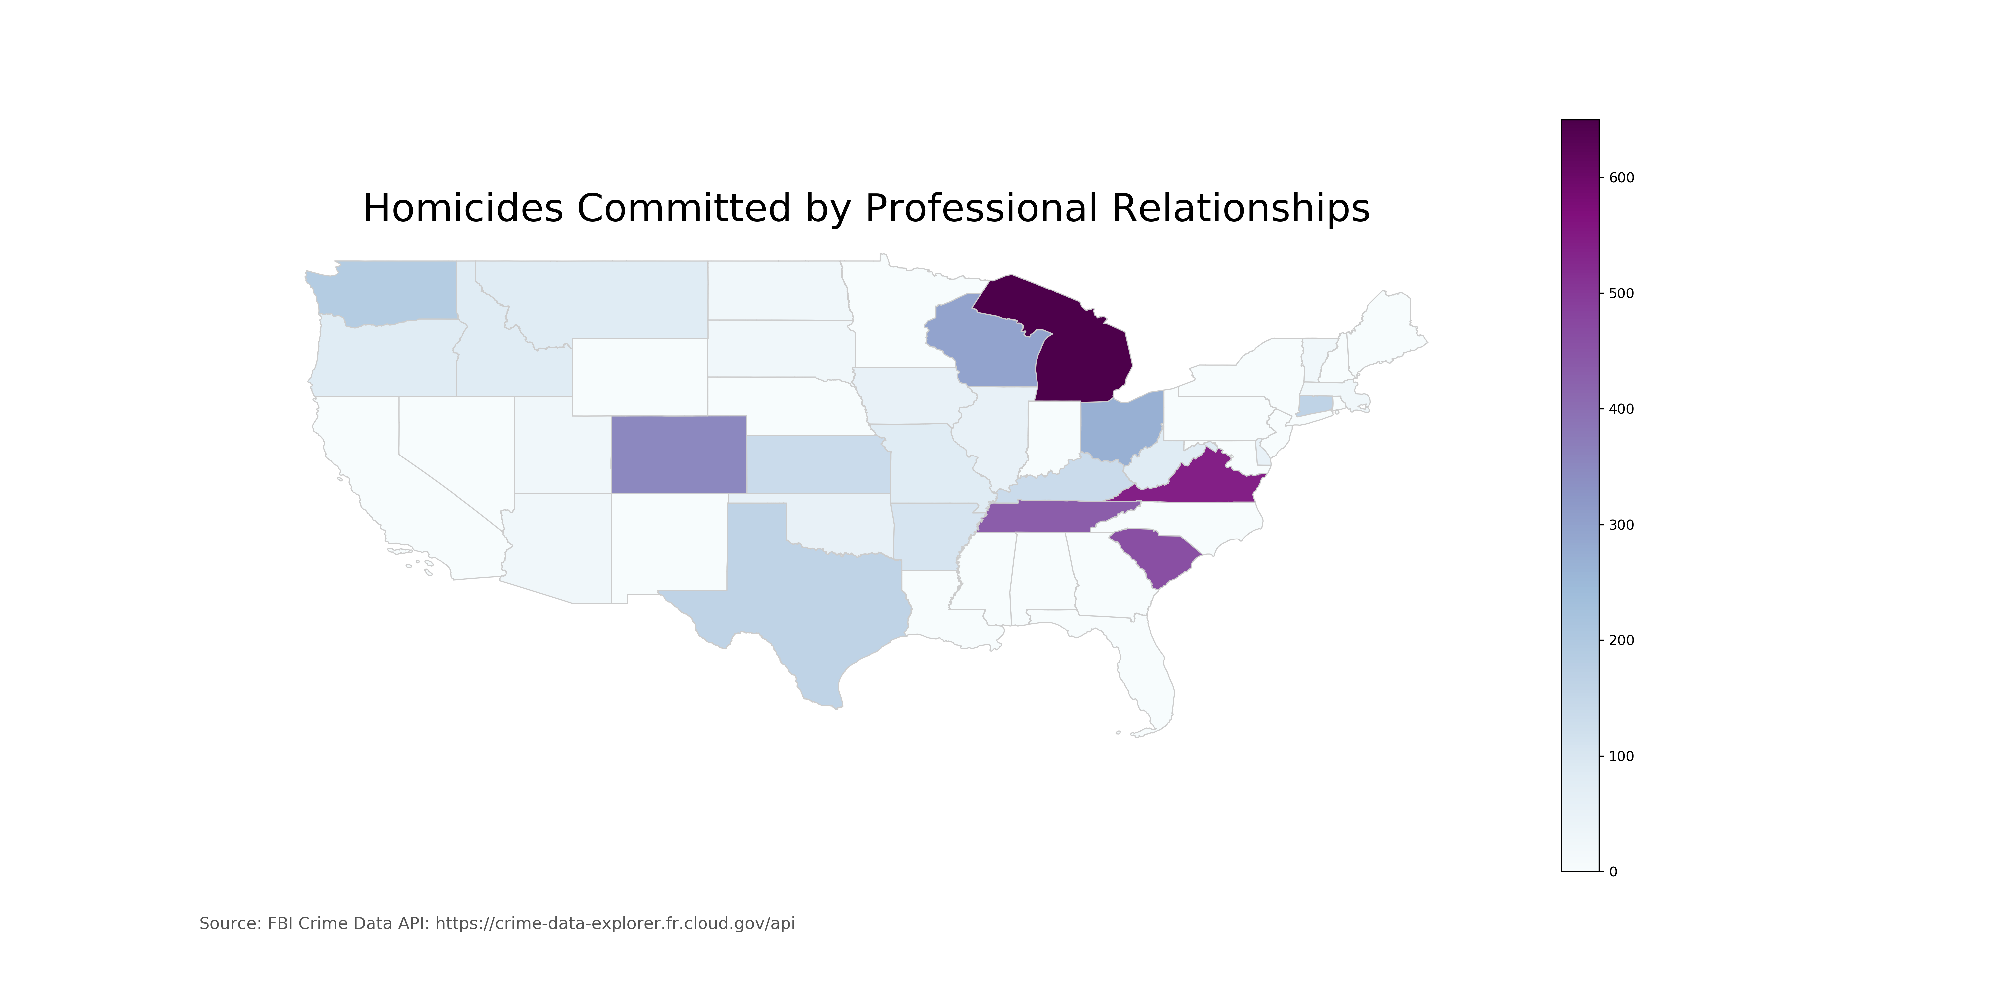

Slide 27
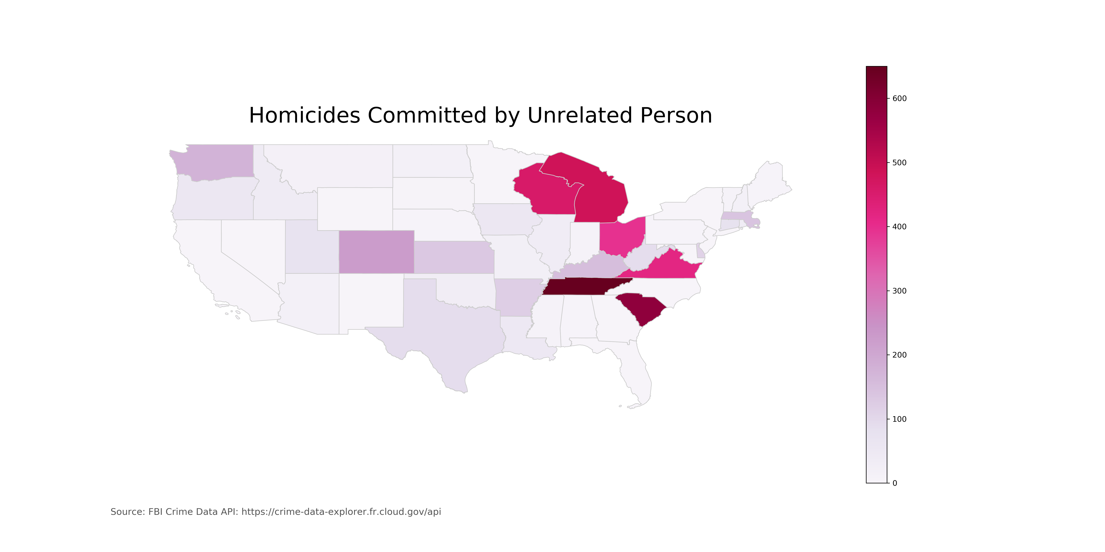

Slide 28
POST MORTEM
DIFFICULTIES:
Executive decision making on data editing and “importance”
Limitations of the FBI API – certain topics would not have been possible to explore
IF THERE WAS MORE TIME:
Getting to dig deeper into the FBI databases beyond the API, which is quick to access
Be more specific with locations – getting to look into smaller demographic areas
Getting to look into all of the “WHY?” questions that arose in our research

Slide 29

Q & A

